Slide 1
Optimal Power Flow: online algorithm, fast dynamics
Steven Low
August 2016
Notes:
May 2012: Santa Fe Institute Workshop on Smart Grid, Santa Fe, NM
July 2012: Network Science Workshop, Chinese University of Hong Kong, HK (Raymond Yeung)
Sept 2012: Melbourne University, EEE Department (Pascal van Hentenryck)
February 13, 2013: ITA Workshop, San Diego
May 20, 2013: IEEE Workshop on Modeling and Simulation of Cyber-Physical Energy Systems, Berkeley, CA (Peter Palensky, Edward A. Lee)
Oct 31, 2013: Google, Mountain View, CA (Arun Mazumdar)
Nov 5, 2013: Asilomar Conference, invited session on Power Networks (Edmund Yeh)
Nov 15, 2013: NSF Workshop on Smart Grid, Washington DC (Giannakis, Sairaj, SL)
Dec 2, 2013: UCLA EE (Mani Srivastava)
Dec 5, 2013: Keynote, GlobalSIP (Global Conf on Signal & Info Processing) Symposium on Signal Processing in Smart Grid (Shalinee Kishore, Lalitha Sankar)
Jan 16, 2014: Stanford Smart Grid seminar (Ram Rajagopal, Baosen Zhang)
Feb 4, 2014: 9th Annual CARNEGIE MELLON CONFERENCE ON THE ELECTRICITY INDUSTRY, (Marija Ilic, Krishnan Kant)
May 22, 2014: UC Berkeley (Kameshwar)
Oct 3, 2014: ASU (Junshan Zhang)
Nov 3, 2014: Asilomar Conference, invited session on Smart Grid: learning and optimization, Pacific Grove, CA
Nov 10, 2014: EE Control Group, Berkeley (Claire Tomlin)
Jan 16, 2015, Grid Science Winter School and Conference (Scott Backhaus, Misha Chertkov)
June 9, 2015: Advanced Mathematical Methods For Energy Systems: from Theory to Practice, Moscow, Russia (Janusz Bialek, Skoltech)
July 7, 2015, Tsinghua power systems group (Prof Song Yonghua)
July 21, 2015: Hong Kong University, EEE (David Hill, Victor Li)
Online algorithms for power systems
============================
Jan 14, 2016: IPAM Workshop on Optimization and Equilibrium of Energy Economics, UCLA, CA (Mike Ferris)
Jan 28, 2016: ESIF Workshop on Frontiers in Distributed Optimization and Control of Sustainable Power Systems, NREL, Golden, CO (Emiliano Dall’Anese, Brian Johnson)
Feb 8, 2016: PNNL (Jakob Stoustrup)
Feb 10, 2016: Georgia Tech, School of Industrial & Systems Engineering (Andy Sun)
March 10, 2016: Caltech CMI Faculty talk (Michelle Effros)
March 17, 2016: CISS Plenary talk, Princeton, NJ (Mung Chiang)
April 10, 2016: Tsinghua Electrical Engineering Dept (Profs Liu and Mei)
April 2016: Zhejiang University, EE (Prof Song Yonghua)
May 19, 2016: Information Modeling and Control of Complex Systems Workshop (Ohio State University, Ness Shroff)
June 16, 2016: ETH, Power Systems Lab (Goran Andersson)
June 26, 2016: Keynote, Conf on Uncertainty in Artificial Intelligence
OPF: relaxations, online algorithms, fast dynamics
=========================================
June 30, 2016: Simons Institute Workshop on Real-time Decision Making (Dick Karp)
July 14, 2016: GE Grid Solutions Monthly Tech Talk, Redmond, WA (Kwok Cheung)
August 26, 2016: EEE Department, University of Melbourne (Rob Evans)
Sept 6, 2016: EECS, University of Michigan (Johanna Mathieu)
Sept 23, 2016: EE, Harvard University (Lina Li)

Slide 2
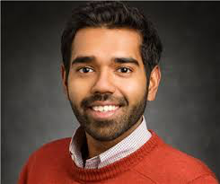

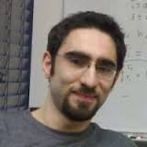
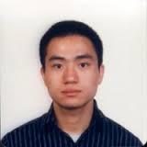
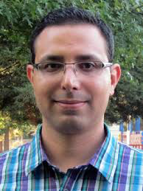
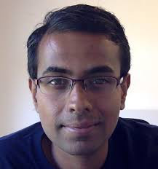
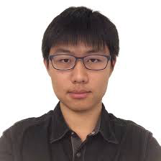
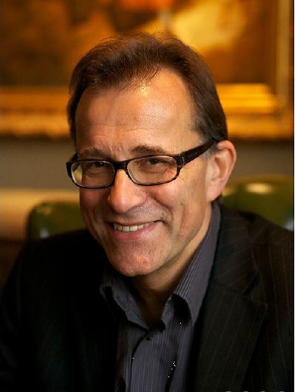
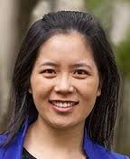
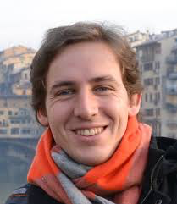
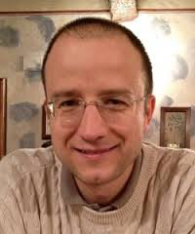
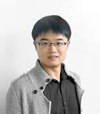








OPF
relaxation
Bose (UIUC)
Chandy
Farivar
Gan (FB)
Lavaei (UCB)
Online OPF
Gan (FB)
Dvijotham (PNNL)
Tang
Dynamics
Bialek (Skoltech)
Li (Harvard)
Mallada (JHU)
Topcu (Austin)
Zhao (NREL)

Slide 4
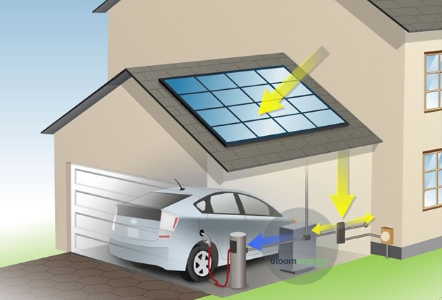
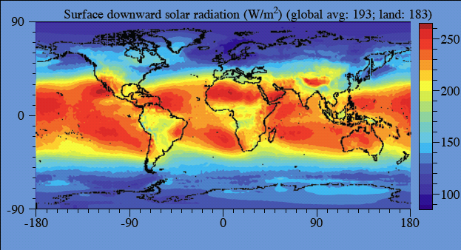

Solar power over land:
> 20x world energy demand
network of
billions of active distributed energy resources (DERs)
DER: PV, wind tb, EV, storage, smart bldg / appl

Slide 5
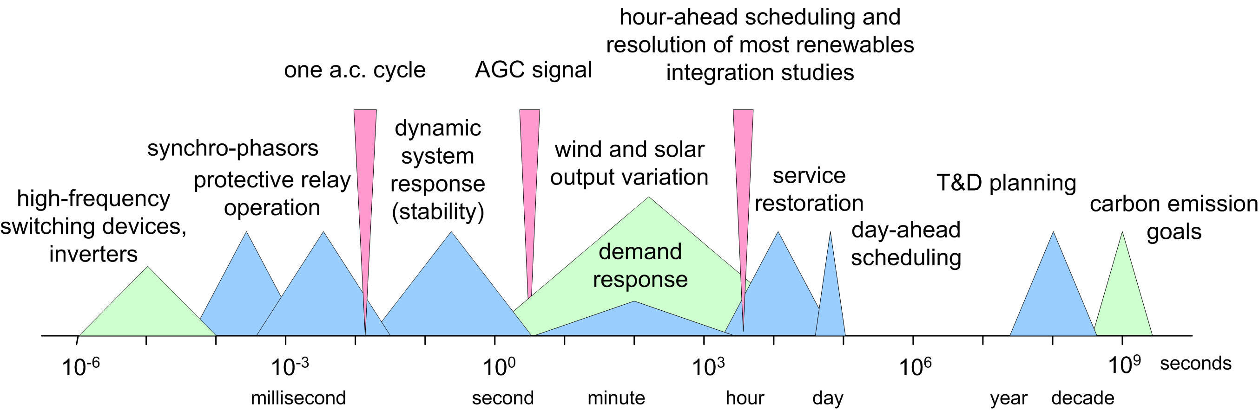
Multiple timescales
System dynamics and controls at different timescales
require different models
dynamic models
(ODEs)
power flow models
(algebraic equations)

Slide 6
Optimal power flow (OPF)
OPF is solved routinely for
network control & optimization decisions
market operations & pricing
at timescales of mins, hours, days, …
Non-convex and hard to solve
Huge literature since 1962
Common practice: DC power flow (LP)
Also: Newton-Raphson, interior point, …

Slide 7
Optimal power flow (OPF)
OPF problem underlies numerous applications
nonlinearity of power flow equations ➔ nonconvexity
Ian Hiskens, Michigan

Slide 8
How to deal with nonconvexity
of power flows?
Two ideas
exact semidefinite relaxation
Tutorial:
L, Convex relaxation of OPF, 2014
http://netlab.caltech.edu

Slide 9
How to deal with nonconvexity
of power flows?
Two ideas
exact semidefinite relaxation
use grid as implicit power flow solver

Slide 10
Key message
Large network of DERs
Real-time optimization at scale
Computational challenge: power flow solution
Online optimization [feedback control]
Network computes power flow solutions in real time at scale for free
Exploit it for our optimization/control
Naturally adapts to evolving network conditions
Examples
Slow timescale: OPF
Fast timescale: frequency control

Slide 11
Outline
Semidefinite relaxations of OPF
Power flow models
Offline algorithms
Online OPF
Power flow models
Load-side frequency control
Dynamic models
Tutorial:
L, Convex relaxation of OPF, 2014
http://netlab.caltech.edu
Zhao, Topcu, Li, L, TAC 2014

Slide 12
Online OPF
Gan (FB)
Dvijotham (PNNL)
Tang

Slide 13
Relaxations of OPF
But traditional algorithms are all offline …
… unsuitable for real-time optimization of
network of distributed energy resources

Slide 14
Relaxations of OPF
We will compare our online algorithm to
relaxation wrt optimality and speed

Slide 15
OPF
power flow equations
operational constraints
controllable
devices
uncontrollable
state
capacity limits

Slide 16
OPF
power flow equations
operational constraints
capacity limits

Slide 17
OPF
power flow equations
operational constraints
capacity limits

Slide 18
OPF: eliminate y

Slide 19
OPF: add barrier
add barrier function
to remove
operational constraints
L: nonconvex

Slide 20
Online (feedback) perspective
cyber
network
measurement,
communication
y(t)
control
x(t)
physical
network

Slide 21
Online gradient algorithm
gradient projection algorithm:
active control
law of physics
Explicitly exploits network as power flow solver
Naturally tracks changing network conditions

Slide 22
Online gradient algorithm
gradient projection algorithm:
active control
law of physics
Results
Optimality
Tracking performance

Slide 23
1. Local optimality
Under appropriate assumptions
x(t) converges to set of local optima
if #local optima is finite, x(t) converges

Slide 24
1. Global optimality
Theorem
If co{local optima} are in A then
x(t) converges to the set of global optima
x(t) itself converges a global optimum if #local optima is finite

Slide 25
1. Global optimality
Theorem
If SOCP is exact over X, then assumption holds

Slide 26
1. Suboptimality gap
any original
feasible pt
slightly away
from X boundary
any local
optimum
Informally, a local minimum is almost as good
as any strictly interior feasible point

Slide 27
2. Tracking performance
static
OPF
drifting
OPF

Slide 28
2. Tracking performance
cost of Alg
dynamic
regret
optimal cost
Theorem
rate of
drifting
subopt of
local min

Slide 29
2. Tracking performance
cost of Alg
dynamic
regret
optimal cost
Theorem
rate of
drifting
subopt of
local min

Slide 30
2. Tracking performance
cost of Alg
dynamic
regret
optimal cost
Theorem
If rate of drifting is then per-step
is asymptotically bounded by
Can made arbitrarily small at cost of computation
(local min)

Slide 31
Simulations

Slide 32
frequency control
Bialek (Skoltech)
Li (Harvard)
Mallada (JHU)
Topcu (Austin)
Zhao (NREL)
Zhao, Topcu, Li, L, TAC 2014
http://netlab.caltech.edu

Slide 33
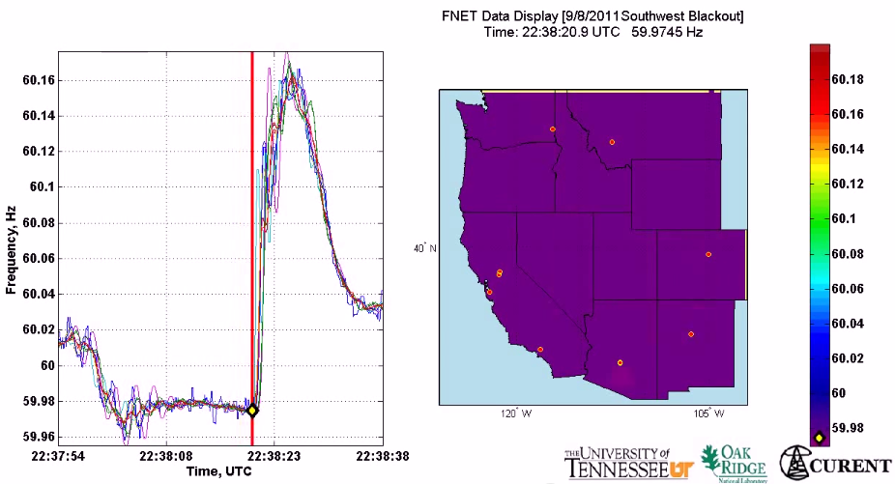
Motivation
All buses synchronized to same nominal frequency (US: 60 Hz; Europe/China: 50 Hz)
Supply-demand imbalance ➔ frequency fluctuation
(1 min)
2011 Southwest blackout

Slide 34
Why load-side participation
Ubiquitous continuous load-side control can supplement generator-side control
faster (no/low inertia)
more reliable (large #)
better localize disturbances
reducing generator-side control capacity
secondary freq control
economic
dispatch
primary
freq control
sec
min
5 min
60 min

Slide 35
What is the potential
Residential load accounts
for ~1/3 of peak demand
61% residential appliances
are Grid Friendly
US:
operating reserve: 13% of peak
total GFA capacity: 18%
Lu & Hammerstrom (2006), PNNL

Slide 36
How
How to design load-side frequency control ?
How does it interact with generator-side control ?

Slide 37
Literature: load-side control
Original idea & early analytical work
Schweppe et al 1980; Bergin, Hill, Qu, Dorsey, Wang, Varaiya …
Small scale trials around the world
D.Hammerstrom et al 2007, UK Market Transform Programme 2008
Early simulation studies
Trudnowski et al 2006, Lu and Hammerstrom 2006, Short et al 2007, Donnelly et al 2010, Brooks et al 2010, Callaway and I. A. Hiskens, 2011, Molina-Garcia et al 2011
Analytical work – load-side control
Zhao et al (2012/2014), Mallada and Low (2014), Mallada et al (2014), Zhao and Low (2014), Zhao et al (2015)
Simpson-Porco et al 2013, You and Chen 2014, Zhang and Papachristodoulou (2014), Ma et al (2014), Zhao, et al (2014),
Recent analysis – generator-side/microgrid control:
Andreasson et al (2013), Zhang and Papachristodoulou (2013), Li et al (2014, 2016), Burger et al (2014), You and Chen (2014), Simpson-Porco et al (2013), Hill et al (2014), Dorfler et al (2014)

Slide 38
Network model
branch power
generator or load
loads:
damping or uncontrollable
i : region/control area/balancing authority

Slide 39
Network model
Generator bus: M_{i} > 0
Load bus: M_{i} = 0

Slide 40
Network model
Generator bus: p_{i} is real power injection
Load bus: p_{i} is controllable load

Slide 41
Generator-side control
generator bus:

Slide 42
Load-side control
Load bus:
how to design feedback control ?

Slide 43
Network model
Suppose the system is in steady state
Then: disturbance in gen/load …

Slide 44
Load-side controller design
Control goals (while min disutility)
Rebalance power & stabilize frequency
Restore nominal frequency
Restore scheduled inter-area flows
Respect line limits
Zhao, Topcu, Li, Low
TAC 2014
Mallada, Zhao, Low
Allerton, 2014

Slide 45
Load-side controller design
Control goals (while min disutility)
Rebalance power & stabilize frequency
Restore nominal frequency
Restore scheduled inter-area flows
Respect line limits
Zhao, Topcu, Li, Low
TAC 2014
Mallada, Zhao, Low
Allerton, 2014

Slide 46
Load-side controller design
Design control law
whose equilibrium
solves:
load disutility
power balance
inter-area flows
line limits
Control goals (while min disutility)
Rebalance power & stabilize frequency
Restore nominal frequency
Restore scheduled inter-area flows
Respect line limits
freq will emerge as
Lagrange multiplier
for power imbalance

Slide 47
Load-side controller design
Design control (G, F) s.t. closed-loop system
is asymptotically stable
has equilibrium that is optimal
power network
load control

Slide 48
Load-side controller design
Idea: exploit system dynamic as part of primal-dual algorithm for modified opt
Distributed algorithm
Control goals in equilibrium
Stability analysis
power network
load control

Slide 49
Summary: control architecture
physical network
Primary load-side frequency control (linear PF)
completely decentralized
Theorem: globally stable dynamic, optimal equilibrium
Zhao, Topcu, Li, Low. TAC 2014

Slide 50
Summary: control architecture
physical network
cyber network
Secondary load-side frequency control (linear PF)
communication with neighbors
Theorem: globally stable dynamic, optimal equilibrium
Mallada, Zhao, Low. Allerton 2014

Slide 51
Summary: control architecture
physical network
cyber network
With generator-side control, nonlinear power flow
load-side improves both transient & eq
Theorem: stable dynamic, optimal equilibrium
Zhao, Mallada, Low. CISS 2015

Slide 52
Simulations
Dynamic simulation of IEEE 39-bus system
Power System Toolbox (RPI)
Detailed generation model
Exciter model, power system
stabilizer model
Nonzero resistance lines

Slide 53
Primary control

Slide 54
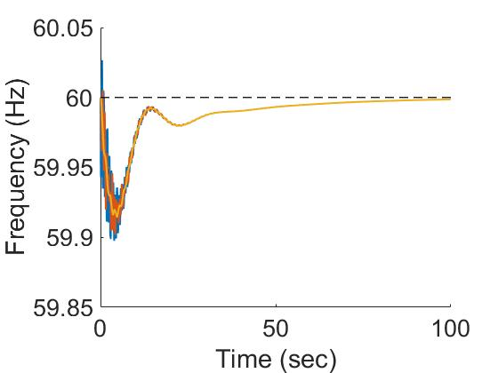
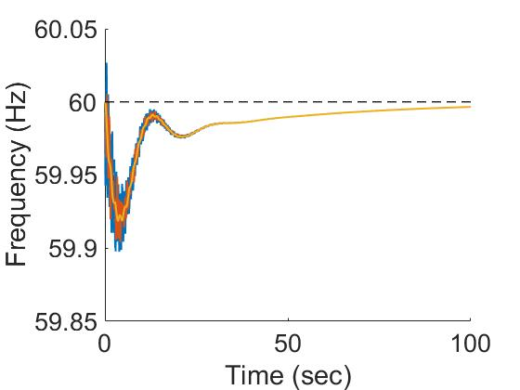
Secondary control
Traditional AGC
Unified Control
Similar shape but local frequencies differ more, higher control effort, slightly longer settling time

Slide 55
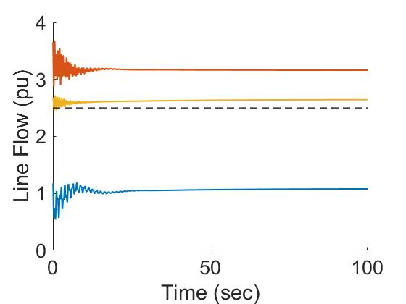
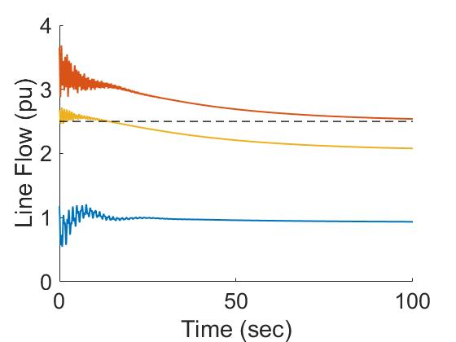
Secondary control
Traditional AGC
Unified Control
AGC blind to line limits
Unified Control enforces line limits

Slide 56
Key message
Large network of DERs
Real-time optimization at scale
Computational challenge: power flow solution
Online optimization [feedback control]
Network computes power flow solutions in real time at scale for free
Exploit it for our optimization/control
Naturally adapts to evolving network conditions
Examples
Slow timescale: OPF
Fast timescale: frequency control

